Slide 1
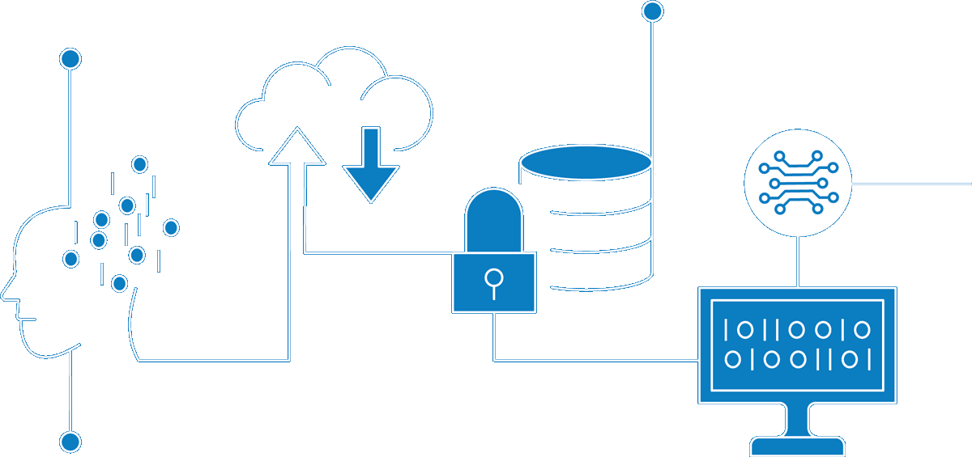
Enterprise Cloud Data Platform – Snowflake Capabilities
Enterprise Information Architecture
Author Nishit Ajwaliya
Date September 2022
Version v1.0
Status DRAFT

Slide 2
Summary
Snowflake is an enterprise cloud data platform of the NationalGrid. This document provides high level overview of core features of the Snowflake specially, Snowpark. It also provides reference to a draft decision tree to help making decision on when to use Snowflake and when to not use Snowflake.

Slide 3
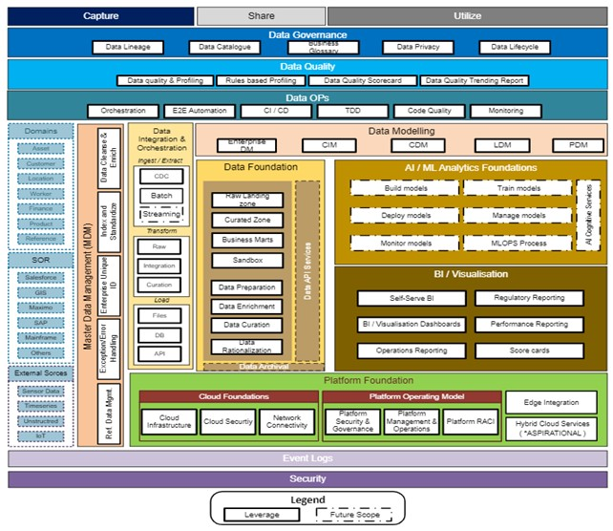
NG Reference Data Architecture

Slide 4

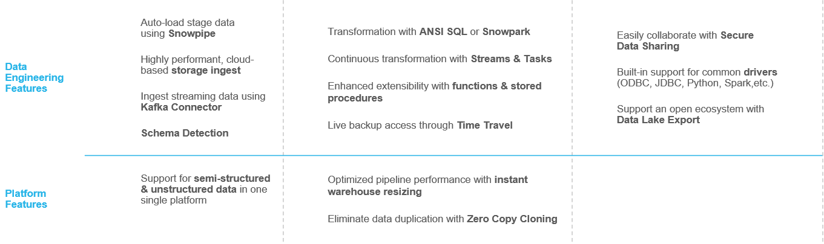

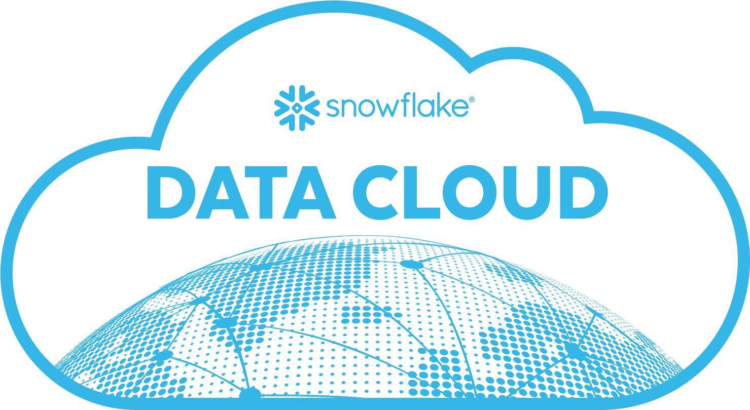


Snowflake Data Engineering Feature Set
1
2
3
Concurrency scaling with multi-clustered warehouse
Supports Azure, AWS, and GCP cloud
Security
Features
Role based Access control with NG Azure AD
Row and Column level data protection

Slide 5
Draft Data Store Decision Tree
Reference - Enterprise Data Platform Data Usage Patterns and Decision Tree draft.pdf

Slide 6
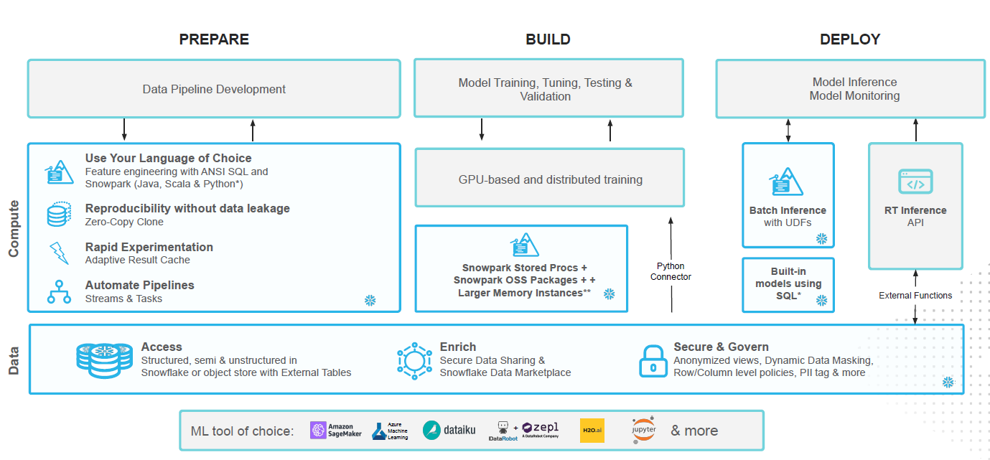
Machine Learning With Snowflake using Snowpark

Slide 7
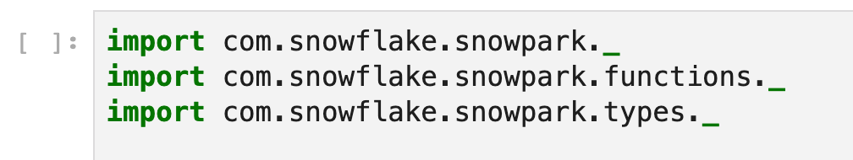
SNOWPARK
A new developer experience that allows you to write Snowflake code in your preferred way, and execute it directly within Snowflake.
snowdf = session.table("products").filter(col("id") === 1)
select * from products where id = 1;
Snowpark pushes all of its operations directly to Snowflake without any other intermediary.

Slide 8


Slide 9


